Slide 1
Accuracy of weapon stand
George (gosha) dozoretz

Slide 2
Objective
Simulates fire of weapons stand in different ranges
Visualize results
Look for ways to improve accuracy

Slide 3
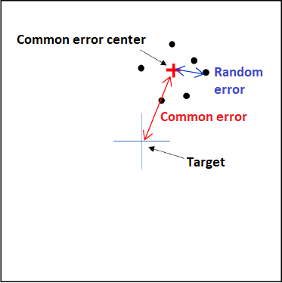
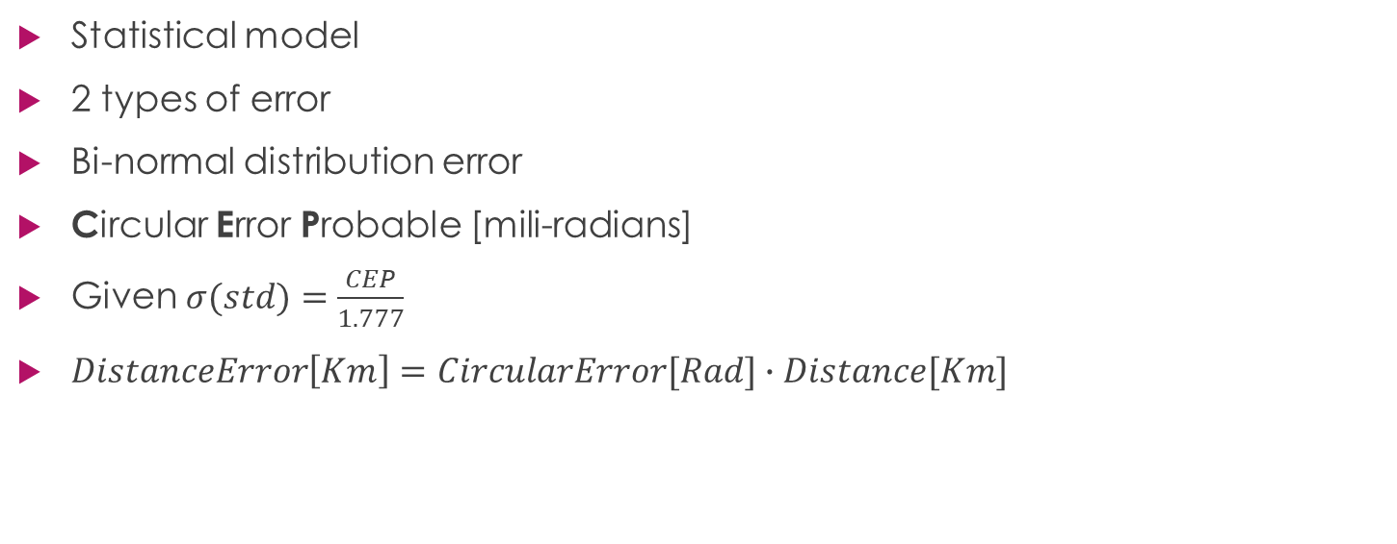
Mathematical model
Statistical model
2 types of error
Bi-normal distribution error
Circular Error Probable [mili-radians]
Given $σ(std)=\frac{CEP}{1.777}$
$DistanceError\left[Km\right]=CircularError[Rad]∙Distance[Km]$

Slide 4
Method
‘monte carlo’ simulation N times, for hit coordinates of each burst fired, for given distance and burst length.

Slide 5
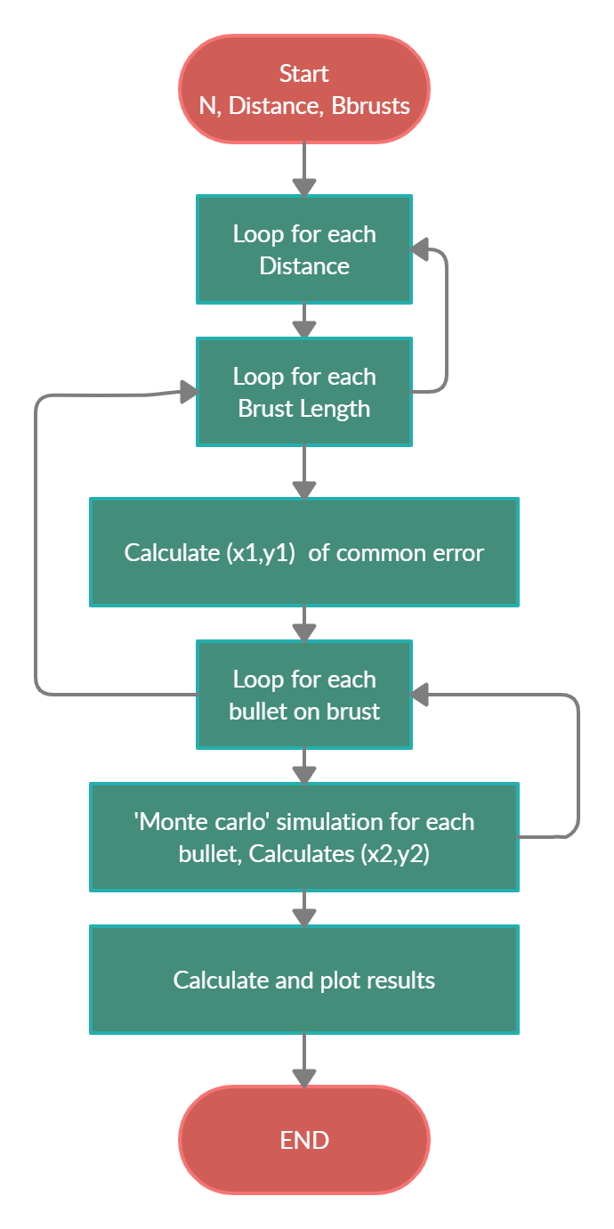
Algorithm
Object based model
For each distance preforming experiment
For each burst length in experiment calculating N times common error coordinates (x1,y1)
For each burst(x1,y1), simulates by ‘monte carlo’ fire of the bullets (x2,y2) coordinates

Slide 6
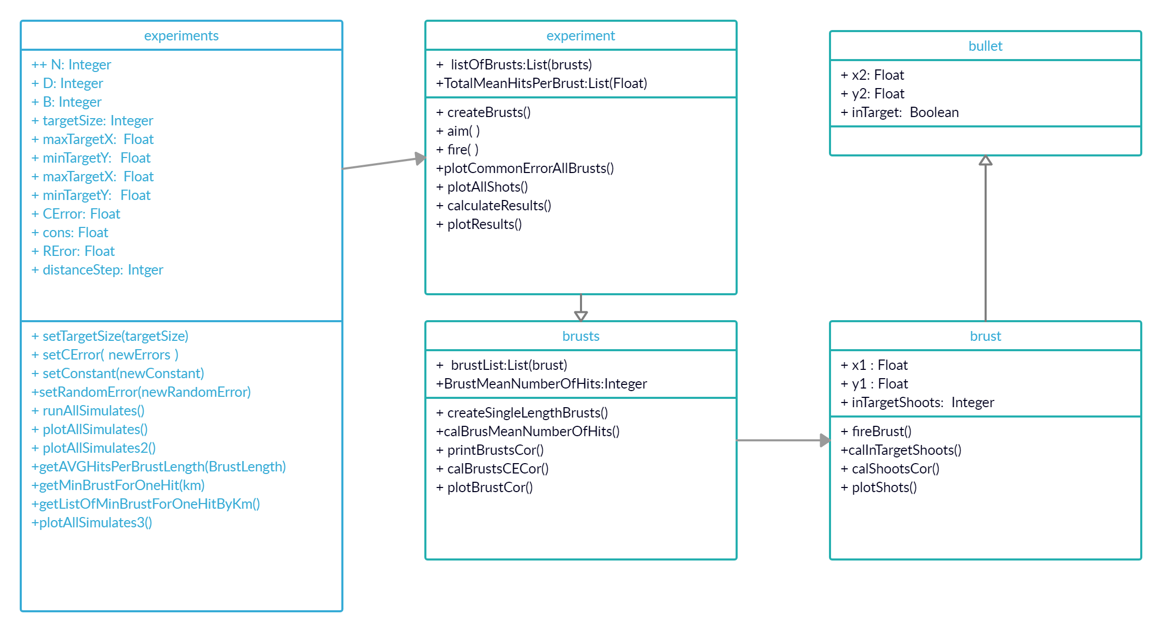
Class diagram

Slide 7
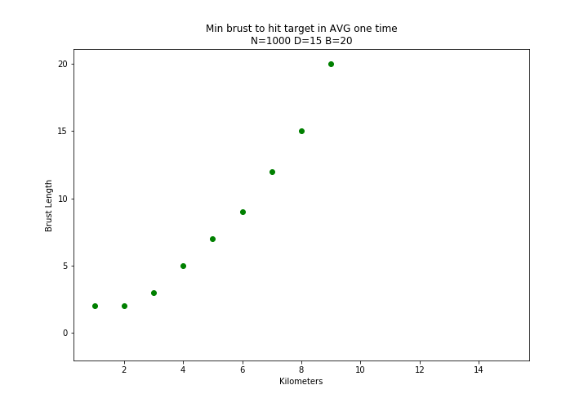
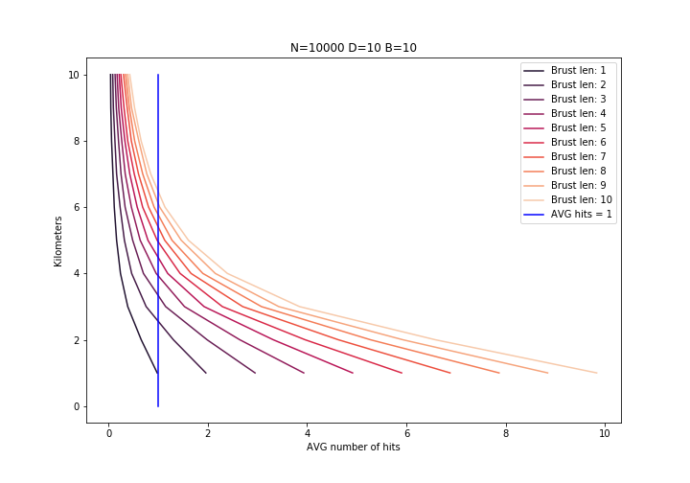
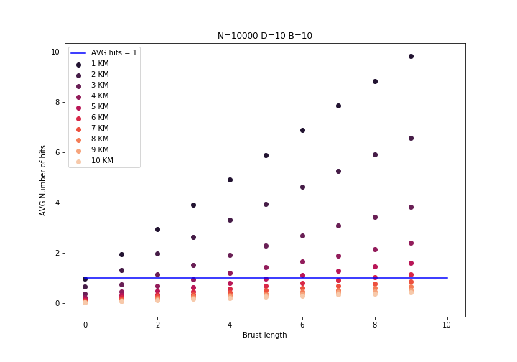
Results

